Slide 1
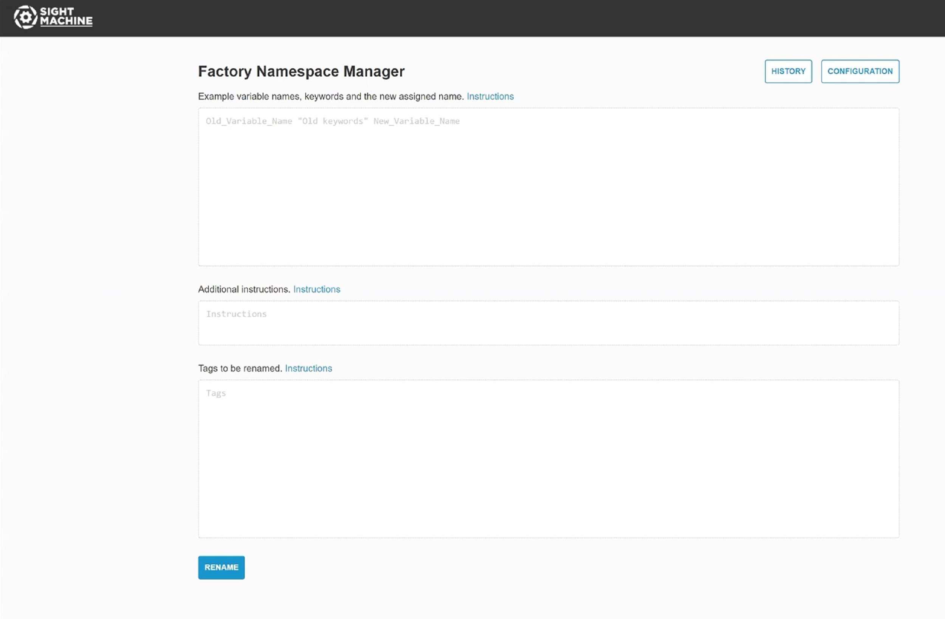
Factory Namespace Manager
The fragmented state of factory data has been a severe roadblock to scaling AI for manufacturers.
Factory Namespace Manager is a Small Language Model that converts diverse factory data naming systems into standardized corporate formats.
High-speed, high-volume data mapping replaces slow, manual work by subject matter experts, typically done for only a small subset of data.
Now available in Microsoft Azure AI model catalog.

Slide 2
Making Factory Data AI-Ready
Small language model analyzes a sample of renamed data to learn patterns behind data naming conventions. Doesn’t require detailed renaming rules.
Translates inconsistent data field names into standardized corporate formats for use in data dictionaries or unified namespace.
Exports data to Sight Machine or any ERP, BI, analytics or data governance system.
Makes the universe of factory data AI-ready. Enables integration of factory data with enterprise data systems and tools for end-to-end optimization.

Slide 3
IDC: Most industrial companies struggling to leverage AI at scale due to condition of their data
“I’ve spoken to dozens of industrial companies about their current and potential use of AI in factory operations and the overwhelming feedback I hear and see in IDC survey data is that most companies are struggling to leverage AI effectively at scale due to the condition of their data.
They have this dilemma that contextually similar data is formatted in multiple ways and is difficult to source and normalize amidst a complete lack of historical governance and data architecture.
What I’ve heard loud and clear is that technology that helps to solve this challenge and reduce the labor requirement to decipher data will be readily adopted.”
– Jonathan Lang, Research Director of Worldwide IT/OT Convergence Strategies at IDC

